Slide 1
Analyzing The Impact Of Car Features On Price And Profitability
Final Project - 3

Slide 2
Agenda
Project Description
Approach
Tech Stack Used
Insights
Result

Slide 3
PROJECT DESCRIPTION
The automotive industry has been quickly developing over the past few decades, with a growing focus on fuel efficiency, environmental sustainability, and technological innovation. With increasing competition among makers and a changing consumer scene, it has become more significant than ever to understand the factors that drive consumer demand for cars.
Lately, there has been a developing pattern towards electric and crossover vehicles and expanded interest in elective fuel sources like hydrogen and natural gas. Simultaneously, traditional gasoline-powered cars stay prevalent in the market, with varying fuel types and grades available to consumers.

Slide 4
Dataset Description:
The dataset contains information on various car models and their specifications, and is titled "Car Features and MSRP". It was collected and made available on Kaggle by Cooper Union, a private college located in New York City.
Here is a brief overview of the dataset:
Number of observations: 11,159
Number of variables: 16
File type: CSV (Comma Separated Values)

Slide 5
The variables in the dataset are:
Make: the make or brand of the car
Model: the specific model of the car
Year: the year the car was released
Engine Fuel Type: the type of fuel used by the car (gasoline, diesel, etc.)
Engine HP: the horsepower of the car's engine
Engine Cylinders: the number of cylinders in the car's engine
Transmission Type: the type of transmission (automatic or manual)
Driven_Wheels: the type of wheels driven by the car (front, rear, all)

Slide 6
Number of Doors: the number of doors the car has
Market Category: the market category the car belongs to (Luxury, Performance, etc.)
Vehicle Size: the size of the car
Vehicle Style: the style of the car (Sedan, Coupe, etc.)
Highway MPG: the estimated miles per gallon the car gets on the highway
City MPG: the estimated miles per gallon the car gets in the city
Popularity: a ranking of the popularity of the car (based on the number of times it has been viewed on Edmunds.com)
MSRP: the manufacturer's suggested retail price of the car

Slide 7
Data cleaning and pre-processing:
I imported 11915 records and 16 columns ,then studied the data set: Car’s brand, model, pricing and other columns that described other features of the car.
Prior to plunging into the analysis of the given dataset, it is essential to perform intensive data cleaning to guarantee precise and reliable outcomes.
There were some rows that contained blank values, and for searching these values, I used COUNTBLANK function. But there were very few missing values (Engine HP, number of doors and Engine cylinder contained very few blank values).
We can replace these blank values that might be needed for the analysis using mean, median (numerical data) and mode (categorical data).

Slide 8
So, I replaced the blank values in column EngineHP, Engine Cylinders and No. of doors with median of the values given.
For the values which could not be imputed, delete rows where data is missing (in Engine fuel type column).
After this whole process, we are left with 11912 rows/values.
Working file link:
https://drive.google.com/drive/folders/1g4V4p4fEZ_L6Un7an_e8aGEb658mN4J3?usp=sharing

Slide 9
APPROACH
For the given dataset, as a Data Analyst, the client has asked How can a car manufacturer optimize pricing and product development decisions to maximize profitability while meeting consumer demand?
This issue could be approached by analyzing the relationship between a car's features, market category, and pricing, and recognizing which features and categories are most popular among customers and most profitable for the manufacturer.
By utilizing data analysis techniques such as regression analysis and market segmentation, the manufacturer could develop a pricing strategy that balances consumer demand with profitability, and distinguish which product features to focus on in future product development efforts. This could help the manufacturer improve its competitiveness in the market and increase its profitability in the long run.

Slide 10
Descriptive statistic is used and made frequency table along with it to see the distribution and spread of the data around the mean and the outliers.
Various Excel formulas, functions and pivot table is used for the calculation and analysis of the variables, if exists, looking for the correlation among them.
Plot various charts or graphs, as applicable for best visualization of the data.
Charts can create a clearer picture of a set of data values than a table with rows of numbers in it, allowing stakeholders to incorporate this understanding into analysis and future planning.

Slide 11
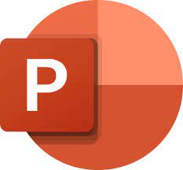

TECH STACK USED
Microsoft Excel
I used Microsoft excel while working on this project. The reason behind using it is because it makes it easier to analyze the dataset. It has various options to conduct in-depth analysis like Analysis tool pack for statistical analysis, pivot table for summarizing data, filters and slicers, charts, and plots for visualization.
Microsoft PowerPoint
For preparing the report, I used Power point, as it allows presenters to translate complex ideas, facts, or figures into easily digestible visuals.

Slide 12
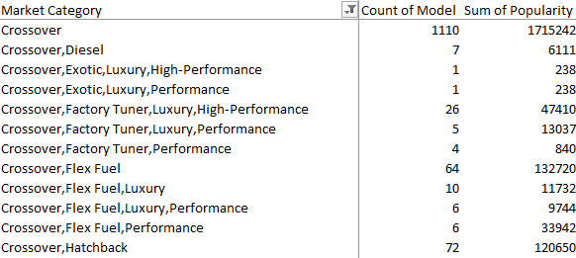
INSIGHTS
Insight Required 1: How does the popularity of a car model vary across different market categories?
We created a pivot table that shows the number of car models in each market category and their corresponding popularity scores.
The pivot table comes out to be like this as shown.

Slide 13
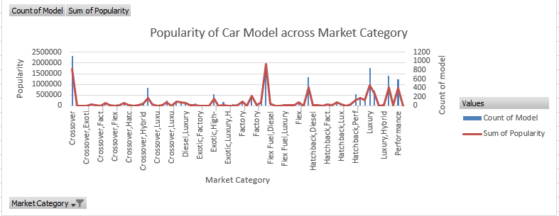
We then made a combo chart out of the data given and inferred that crossover, flex fuel diesel type cars have the most popularity.
Market category: Performance, Hybrid has the least popularity.
It was seen that with increase in market category count popularity also increases, which implies those cars that have market category count more has more popularity.

Slide 14
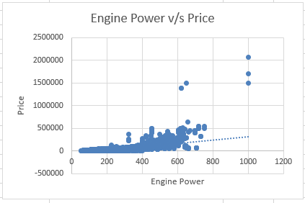
Insight Required 2: What is the relationship between a car's engine power and its price?
Created a scatter plot between engine horsepower v/s price, on x-axis and y-axis respectively.
If we calculate the correlation between the two variables, we will see that the correlation is positive (0.66), indicating that when one variable increases the other one also increases.
So, it implies that when a car’s engine power increases, its price also increases.

Slide 15
Insight Required 3: Which car features are most important in determining a car's price?
We perform regression analysis on the retail price of the car with other prospective variables to understand which variables have the strongest relationship with the car’s price.
We consider variables such as EngineHP, engine cylinders, number of doors, popularity etc. and perform regression analysis to determine the regression statistics.
The Multiple R is the Correlation Coefficient that measures the strength of a linear relationship between two variables. The larger the absolute value, the stronger is the relationship.
1 means a strong positive relationship
-1 means a strong negative relationship
0 means no relationship at all

Slide 16
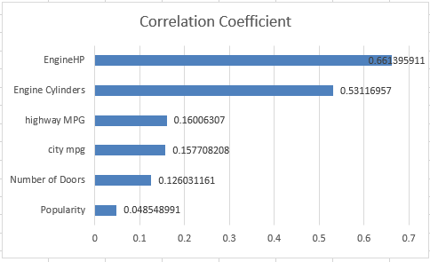
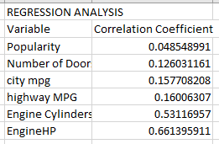
From the graph, we can see that Popularity, Number of doors, city MPG and highway MPG has little to no correlation with MSRP.
While Engine cylinders and Engine HP have a strong positive relationship with MSRP.

Slide 17
Insight Required 4: How does the average price of a car vary across different manufacturers?
Created a pivot table that shows the average price of cars for each manufacturer.
We then plot a bar chart for easy visualization of the data.
We can see from the chart that Buggati has the highest average price, followed by Maybach and Rolls Royce.
While the lowest average price is of Plymouth, that is 3122 only.
Those manufacturers that make luxury cars as they are having extraordinary features that aren’t available in a normal car has price higher and this might be a reason of average price of a car varying with manufacturers.

Slide 18
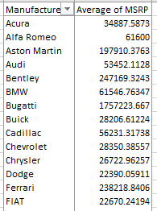

Slide 19
Insight Required 5: What is the relationship between fuel efficiency and the number of cylinders in a car's engine?
On plotting a scatter chart with number of cylinders (x-axis) v/s Highway mpg (y-axis), we get a graph as shown here. The trendline is receding downwards, which indicates that there is a negative relation between the number of engine cylinders and the estimated miles per gallon the car gets on the highway.
The correlation coefficient between the number of cylinders and highway MPG comes out to be -0.59. which indicates that when value of one variable increases, the value of the other decreases.
It is pretty much evident that when number of cylinders increases, the fuel efficiency will decrease.

Slide 20
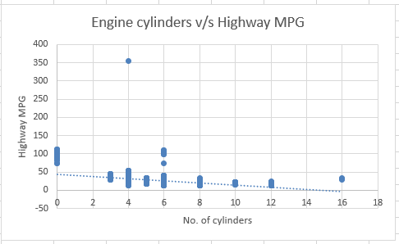

Slide 21
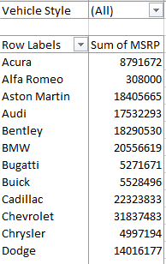
Building the Dashboard:
Task 1: How does the distribution of car prices vary by brand and body style?
After creating a pivot table out of the columns Make, vehicle style and MSRP, we applied a filter on vehicle style column, so that we can filter out the values we want to analyze.
We then created a stacked column chart for the above columns to understand the distribution of car prices varying by brand and body style

Slide 22
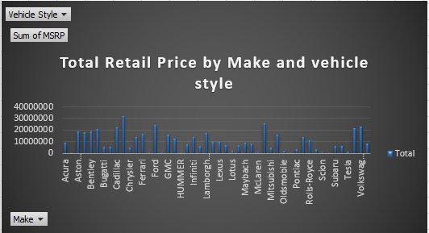
From the chart we can infer that, brand Chevrolet has the highest MSRP, followed by Mercedes Benz.
We can similarly filter out the prices by their body styles also.
Body style of a car vary with compact hatchback to luxury SUV. Also, strong brand name increases price distribution of car.

Slide 23
We can filter the prices by body style also, we will get the visuals as given below:
Body Style: Convertible SUV
Body Style: 4dr Hatchback

Slide 24
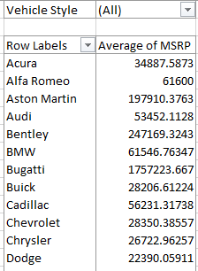
Task 2: Which car brands have the highest and lowest average MSRPs, and how does this vary by body style?
Like the previous task, we will create a pivot table out of the columns Make, vehicle style and MSRP, we applied a filter on vehicle style column, so that we can filter out the values we want to analyze.
We then create a Clustered column chart to compare the average MSRPs across different car brands and body styles.

Slide 25
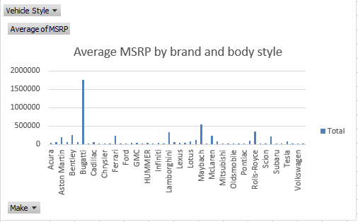
From the chart it is clearly visible that Buggati has the highest average price, of 1757223.7 (~17 lakh 57 thousand).
Also, as for the lowest average price, Plymouth is the one with the average price of 3122.9024 (~3 thousand).

Slide 26
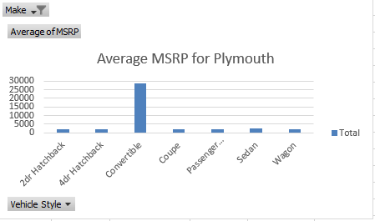
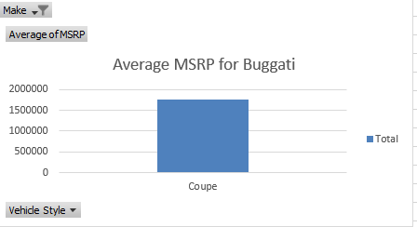
If the lowest or highest average price is not clearly distinguishable from the chart, we can use inbuilt mathematical functions, max and min to determine the said values.
If we analyze the said columns according to vehicle style, we will see that among the brand Buggati, coupe vehicle type alone has the highest average price.
Similarly for the brand Plymouth, vehicle type 2dr hatchback, 4dr hatchback, Coupe and Wagon all have the lowest average price of 2000.

Slide 27
Task 3: How do the different feature such as transmission type affect the MSRP, and how does this vary by body style?
Created a Scatter plot chart to visualize the relationship between MSRP and transmission type, with different symbols for each body style.
• I don’t find any positive or negative relationship between transmission type, MSRP and varying body style. These variables are not at all related with each other.
Calculated the average MSRP for each combination of transmission type and body style using pivot table.

Slide 28
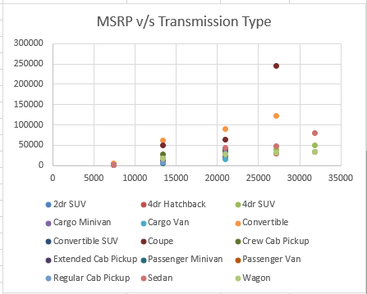
Automated manual has very high average MSRP with body style coupe and convertible.
In general, it could be inferred that Coupe and convertible body style has higher average MSRP in the transmission types and hatchback body style has lower MSRP in all the transmission types.

Slide 29
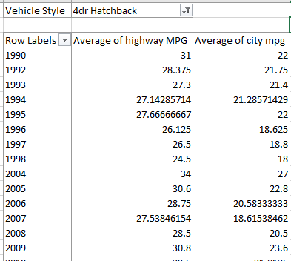
Task 4: How does the fuel efficiency of cars vary across different body styles and model years?
Used pivot table to calculate average of fuel efficiency for different model years.
Added vehicle style as a filter to study the fuel efficiency by body type.
We then insert a line chart to show the trend of fuel efficiency (MPG) over time for each body style

Slide 30
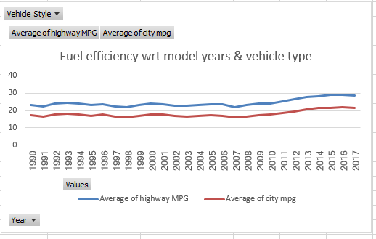
From this chart, it is evident that average of respective MPG of Highway and city, increased over passing model years.
Vehicle style with various cabs, passenger vehicle or pickup vehicle has average MPG lower than those of hatchback, Sedan, wagon that has MPG average comparatively higher over years.
The fuel efficiency of body style 4dr Hatchback has increased to 45 MPG in year 2014 which is the highest of all.

Slide 31
Task 5: How does the car's horsepower, MPG, and price vary across different Brands?
Plotted bubble chart with: Average of engine horsepower on x-axis, Average of Highway MPG on y-axis, Average of MSRP as bubble size and labelled them with the respective brands.
We saw earlier in task 2, that the correlation between engine HP and MSRP is positive that is, an increase in engine HP will increase in MSRP.

Slide 32
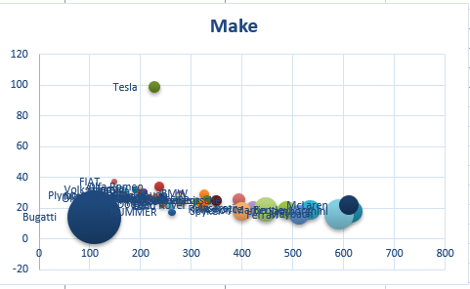
Brand Bugatti has highest engine HP and MSRP but lowest average Highway MPG, which shows that there exists a direct relationship between engine HP and MSRP and these two variables are inversely related to fuel efficiency (MPG).

Slide 33
RESULT
Being a data analyst, we gave significant insights to a car manufacturer and assisted them in optimizing their pricing and product development decisions to maximize benefit while meeting consumer demand.
Analyzed trends in car features and pricing over time
Compared the fuel efficiency of different types of cars.
Investigated the relationship between a car's features and its popularity
Predicted the price of a car based on its features and market category
It was noted during analysis that crossover car and flex fuel cars have high popularity, so in the future developments, a manufacturer needs to focus more on these feature (dual fuel) this would give them competitive advantage in the market over their rivals.

Slide 34
Also, performance, hybrid vehicle is least popular so they need to get more improvised and upgraded in order to get more preference by the consumers.
The manufacturers (Bugatti, Maybach, Rolls Royce, Lamborghini, McLaren) which comes under market category Exotic, Luxury, High performance produces cars with a high average price.
Vehicle style Coupe and convertible car has average price high in all transmission type variants (Automatic, Manual, Automated manual) and transmission type has no relation with the MSRP, this point should be considered by product and development team for effective utilization of this feature with pricing.

Slide 35


THANK YOU
LOOM VIDEO LINKS:
https://www.loom.com/share/c1fb98b81d3741a99df1c6e5c9171d69
https://www.loom.com/share/69ccaf92be9a46b2be272df5f9beb858
https://www.loom.com/share/7c6f2dea861846ec9f38f0ea35b1c852
https://www.loom.com/share/3fc006f901f54e22aa1481660edd8b78
https://www.loom.com/share/df7a1b06acfd4e85a02158f27ece7e12
BY- DEVIKA
DATA ANALYTICS TRAINEE

